Slide 1
Employee Data Analysis using Excel
STUDENT NAME: Mohammed Fazil A
REGISTER NO: 312202274 (NM ID :715D6713211E1948BF34F6CA4C6489D0)
DEPARTMENT: B.com (Computer application)
COLLEGE : Mohamed Sathak College Of Arts & Science

Slide 2
PROJECT TITLE
Employee Performance Analysis using Excel

Slide 3


AGENDA
Problem Statement
Project Overview
End Users
Our Solution and Proposition
Dataset Description
Modelling Approach
Results and Discussion
Conclusion
3/21/2024 Annual Review

Slide 4

PROBLEM STATEMENT
Background:
Provide context about the organization or department. For instance: "In a rapidly growing technology firm, the human resources department is struggling to effectively monitor and enhance employee performance.“
Problem Identification:
Specify the core issue. For example: "The current performance evaluation system lacks consistency and transparency, resulting in unclear performance metrics and dissatisfaction among employees.“
Implications:
Describe the impact of the problem. For instance: "This inconsistency has led to decreased employee morale, lower productivity, and increased turnover rates, which affects overall team performance and organizational growth.

Slide 5

PROJECT OVERVIEW
Employee Data Analyst is a specialized role focused on analyzing and interpreting data related to employees within an organization. Identify trends and patterns in employee performance, turnover rates, engagement levels, and other key metrics

Slide 6

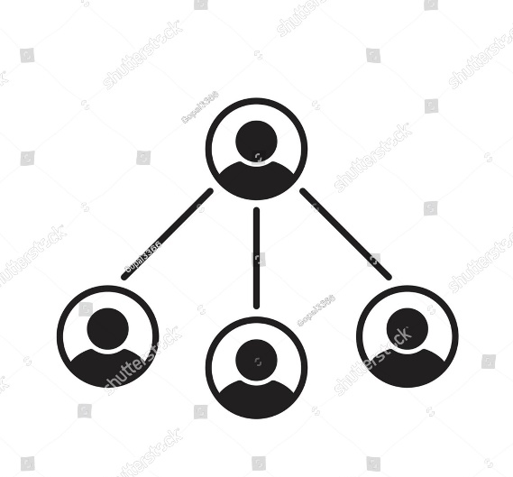


WHO ARE THE END USERS?
Department Managers
Employees
Recruitment Teams

Slide 7

OUR SOLUTION AND ITS VALUE PROPOSITION
Conditional formatting is used to identify any blank or missing columns or rows.
Filter removed from data sheet since it was being exploited for data non-use
A formula is utilized in the data sheet for certain performance in certain rows and columns.
Pivot are used in data sheets o view reports and verify data.
Graph is used for data visualization

Slide 8
Dataset Description
Employee data set in Kaggle
Total 26- features
We have used 9 features
Employee ID in numerical
Name : First and last
Employee type : Full-time, Part-time, Contract
Performance Level : Very High, High, Low, Mid.
Gender : Male & Female
Employee Rating in Numerical values.
Business unit
Slicers
Trend line

Slide 9

THE "WOW" IN OUR SOLUTION
Performance Level =IFS(Z8>=5,"VERY HIGH",Z8>=4,"HIGH",Z8>=3,"MID",TRUE,"LOW")
3/21/2024 Annual Review
9

Slide 10
MODELLING
Data collection
Downloaded Kaggle for project submission
Logged in Edunet website to update the profile and certification
Github has been signed up to generate the github link
Feature Collection
Data validation
Conditional Formatting
Data cleaning
Missing values identify
Missing values making filter out.
Performance Level
Current employee rating
Considering Male and female.
10

Slide 11
MODELLING
Summary
First we have selected the selective column of data we need to Performance analysis
Next we have removed the Blank data though conditional Formatting
The we have filter the data and unselected the Blank
Visualization
We have used the Pivot table.
We have used the graph for the performance analysis.
We have used slicer and axes.
We have used the filter and trendline.

Slide 12
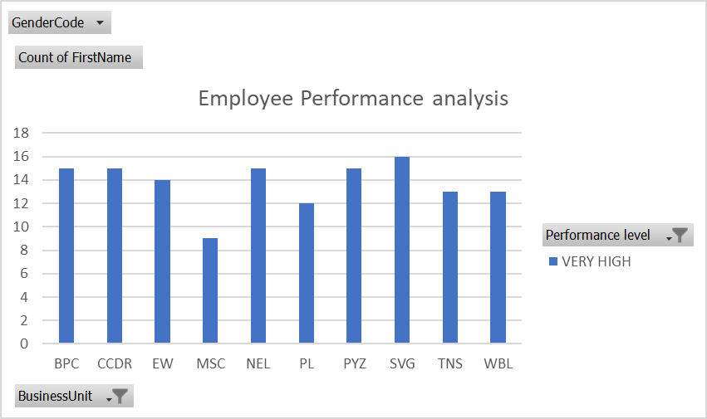
RESULTS

Slide 13
RESULTS

Slide 14
conclusion
Understanding performance trends helps in creating personalized development plans that support employees' career growth and align their goals with organizational objectives. Recognizing and rewarding high performers based on performance data boosts employee morale and motivation. This can lead to increased job satisfaction and retention. The analysis reveals individual and team strengths, as well as areas where improvement is needed. This understanding allows organizations to leverage high performers effectively and address performance gaps. systematically analyzing performance data, organizations can make informed decisions that enhance employee development, optimize performance, and support overall strategic goals. By integrating performance analysis into the organizational culture, companies can foster a high-performance environment that drives success and growth.

